Slide 1
American Asian & Pacific Islander Celebration
at the
RNC Spring Meeting
Special Guests
RNC Chairwoman Ronna Romney McDaniel
RNC Co-Chairman Bob Paduchik
Gov. Eddie Baza Calvo
Gov. Ralph Torres
Congresswoman Amata Radewagen
Utah Attorney General Sean Reyes
Honoring Conservative Asian & Pacific Island Leaders

Slide 2
Honorable Eddie Baza Calvo, Guam
Governor of the United States Territory of Guam

Slide 3
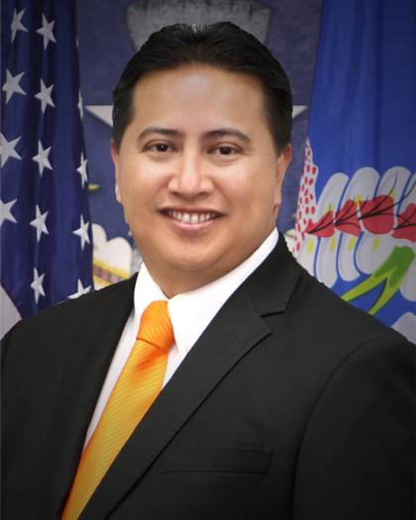
Honorable Ralph Torres, Northern Mariana Islands
Governor of the Commonwealth of the Northern Mariana Islands

Slide 4
Hon. Amata Coleman Radewagen
U.S. Representative for American Samoa
RNC National Committeewoman for American Samoa

Slide 5
Mr. James Ada
RNC Chairman
Republican Party of the Commonwealth of the Northern Mariana Islands
Secretary, Department of Public Works CNMI

Slide 6
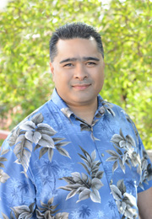
Mr. David Atalig
President of the CNMI San Diego Club

Slide 7
Rep. Ivan Blanco
Republican State Representative, 20th Commonwealth Legislature
Commonwealth of the Northern Mariana Islands

Slide 8
Ms. Jennifer Carnahan
Chairwoman of Minnesota Republican Party
Founder and General Manager of Primrose Park

Slide 9
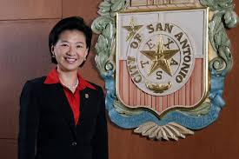
Ms. Elisa Chan
Former San Antonio Council Member

Slide 10
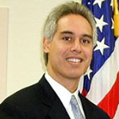
Hon. David Cohen
Former Deputy Assistant Secretary of the Interior
Chairman , National Asian Pacific Center on Aging
Member of the President’s Advisory Commission on Asian Americans and Pacific Islanders

Slide 11
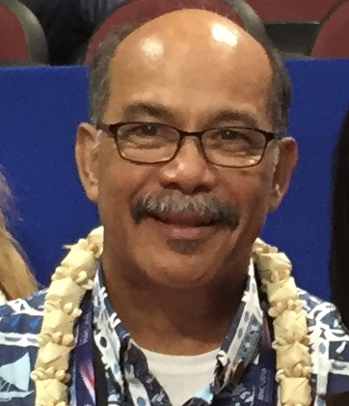
Mr. Victor Cruz
Chairman, the Republican Party of Guam (GOP)

Slide 12
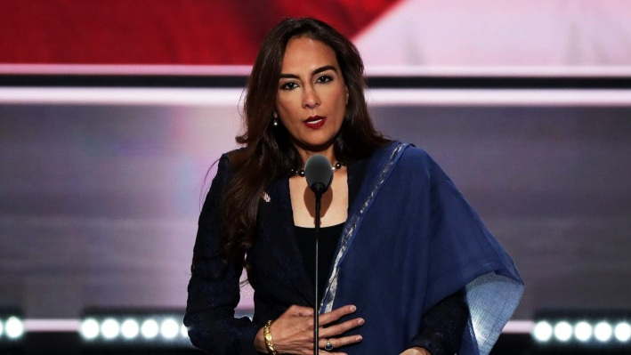
Ms. Harmeet K. Dhillon
Ms. Dhillon, is the Vice Chairman of the California Republican Party.
In 2016, Ms. Dhillon, delivered a moving Sikh prayer during the 2016 Republican
National Convention. Ms. Dhillon is presently being considered by the
WH to lead the Justice Department’s Civil Rights Division

Slide 13
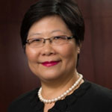
Dr. Helen Van Etten
A Director for Kansas Board of Regents
Republican National Committeewoman

Slide 14
Hon. Chris Cate
6th District Councilman, City of San Diego

Slide 15
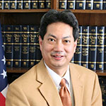
Hon. Ron Falconi
Mayor of Brunswick, first Filipino American Mayor in Ohio

Slide 16
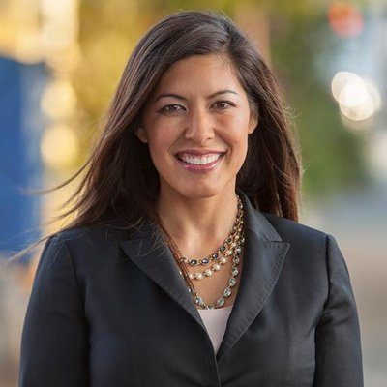
Ms. Denise Gitsham
Hispanic Coalitions Coordinator, Bush Cheney 2000, 1999-2000;
Associate Director, Office of Intergovernmental and Public Liaison,
United States Department of Justice, 2004-2005;
Agency Liaison, The White House, Office of Agency Liaison, 2001.

Slide 17
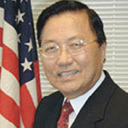
Dr. Paul Jhin
Asian American Outreach Committee Chair,
LA County Republican Party; a long time grassroots Republican leader

Slide 18
Mr. Jonathan Kaji
State of California Commission for Economic Development
Board of Governors, Japanese American National Museum
Member, Little Tokyo Community Council

Slide 19
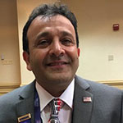
Mr. Hossein Khorram
Vice Chair, USO of the Northeast
founder, American Middle Eastern Coalition for Trump

Slide 20
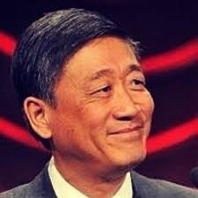
Mr. George Leing
RNC National Committeeman for Colorado

Slide 21
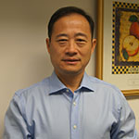
Mr. Cliff Zhonggang Li
Secretary, Asian Pacific Islander Conservative Council
Executive Director, National Committee of Asian American Republicans

Slide 22
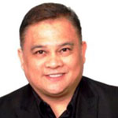
Pastor Herman Martir
President of Asian Action Network and Asian Prayer Network

Slide 23
Ms. Margaret Metcalfe
The National Committeewoman of the Republican Party of Guam.

Slide 24
Ms. Monica Lee Morrill
President, Republican Women of Somerset County Council
Regional Director, PA Federation of Republican Women
RNC Delegate 2016, top vote getter out of 15 candidates in her District

Slide 25
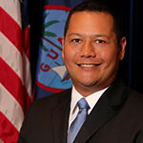
Mr. Jay Rojas
The National Committeeman of the Republican Party of Guam
the Administrator for the Guam Economic Development Authority

Slide 26
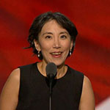
Dr. Lisa Shin
Lisa Shin has been in private practice, as an optometrist, for the past 20 years.
She represented New Mexico as a national delegate and speaker,
at the RNC Convention in 2016.

Slide 27
Mr. Alex Sablan
Vice President Asian & Pacific Islander Conservative Council
Vice President Tan Holdings Corporation

Slide 28
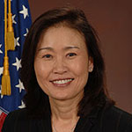
Hon. Michelle Park Steel
Member, Orange County Board of Supervisors
former member of the California State Board of Equalization

Slide 29
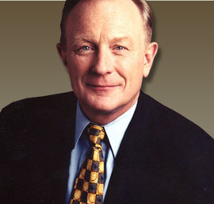
Mr. Shawn Steel
Republican National Committeeman from California
past Chairman of the California Republican Party (GOP)

Slide 30
Mr. Oliver Tan
Director of Coalitions, New York Republican State Committee

Slide 31
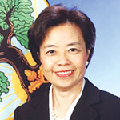
Dr. Marina Tse
The President of the International Education and Leadership
Foundation; former Deputy Assistant Secretary of the US Department
of Education from 2001 to 2005

Slide 32
Mark Tsuneishi
City Commissioner - Torrance, CA
Founder, Asian American Republicans

Slide 33
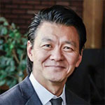
Mr. Derek Uehara
President, Uehara Financial Group, LLC; a 2015 candidate
for Ward 4 of the Henderson, Nevada City Council

Slide 34
David Tian Wang
Founder, Chinese Americans For Trump

Slide 35
State Rep. Gene Ward, Ph. D.
RNC National Committeeman for Hawaii

Slide 36
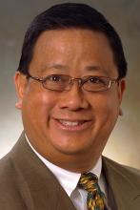
Mr. Earl Wong
Vice Chairman Asian Business Association of San Diego

Slide 37
Ms. Sophie C. Wong
President/Founder, Asian American Republican Women Federated
President, Chinese for Christ Theological Seminary

Slide 38
Mr. Solomon Yue Jr.
RNC National Committeeman for Oregon

Slide 39
Mr. YuKong Zhao
President, Asian American Coalition for Education

Slide 40
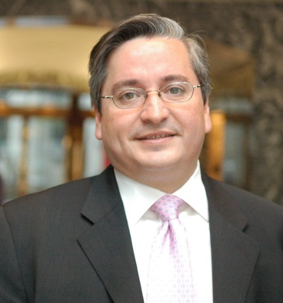
Hon. Juan Carlos Benítez
Former, Special Counsel for Immigration Related Unfair Employment Practices,
U.S. DOJ, Civil Rights Division
President, Asian & Pacific Islander Conservative Council
President, Washington Pacific Economic Development Group

